Slide 1

Hello World!
Grey Hats at UHM

Slide 2

Join us on Slack
https://greyhatsuhm.slack.com/signup

Slide 3
VIM of the Week
VERY Important Meme
#Random
#VIM
#SuperCoolGreyHatMemes
#I<3Hashtags

Slide 4
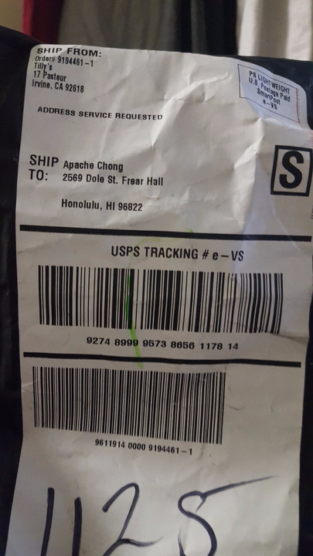
Insert meme here

Slide 5

Python
Compile, run and ship your pseudo-code.

Slide 6
One Snake, Two Snake, Red Snake, Blue Snake
Dynamically Typed
Smaller and more compact code
Faster Development
No Semicolons/Brackets
Notes:
Why use python?

Slide 7
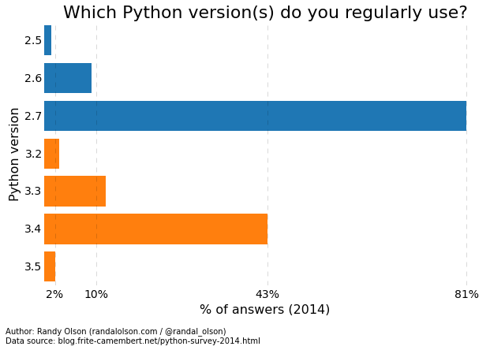
The Great Divide
2.7 vs 3

Slide 8
The Language
Dictionaries → Objects
Lists → Arrays
Lambda → Anonymous function
Booleans (True, False)
&& → and
|| → or
! → not

Slide 9
And More!
Tuples (Lists but Immutable)
Sets

Slide 10
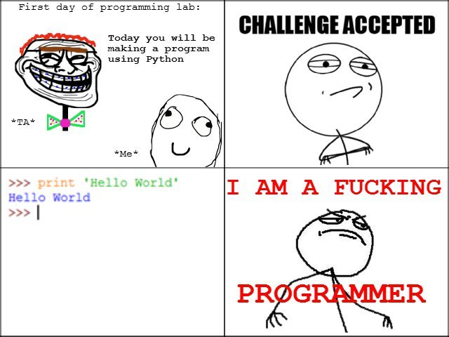
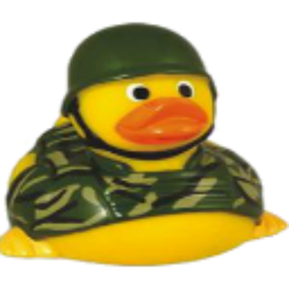
Hello World!
print("Hello World!")

Slide 11
FizzBuzz
for num in range(1,101): msg = '' if num % 3 == 0: msg += 'Fizz' if num % 5 == 0: msg += 'Buzz' print(msg or num)

Slide 12
The Weird Shit
a = 256 b = 256 a is b # True c = 257 d = 257 c is d # False

Slide 13
PIP (Python Package Index)
import *
$ pip install (name)

Slide 14
Let’s Get Started!
Let’s build a web scraper:
https://www.reddit.com/r/programmerhumor

Slide 15
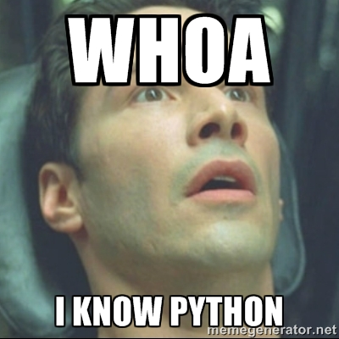
Finale!

